Slide 1
RFID BASED SECURITY
ENTRANCE SYSTEM

Slide 2
COMPONENTS
ESP32
RFID READER
RFID TAG
SERVOMOTOR
BUZZER
BREAD BOARD
JUMPER WIRES

Slide 3
BLOCK DIAGRAM
RFID CARD
ESP32
SERVO
MOTOR
RFID READER
BUZZER

Slide 4
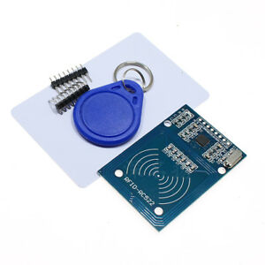
WHAT IS RFID CARD?
`
RADIO FREQUENCY IDENTIFICATION (RFID) is the wireless
Non-contact use of radio-frequency electromagnetic fields
to transfer data for the purposes of automatically identifying
and tracking tags attached to the objects.
It is an extension to barcode

Slide 5
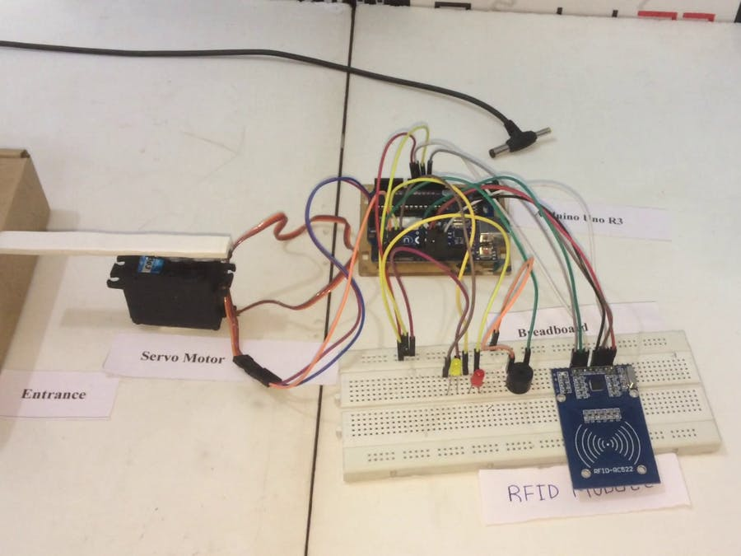
WORKING
RFID based security system using ESP32
project has a RFID reader attached to it.
RFID reader reads the unique alphanumeric code of RFID tags and sends it to ESP32.
Then ESP32 detects whether RFID card is
valid or invalid. If the card is invalid then system turns on the buzzer. However, if the RFID card shown by the user is valid then
the Servo motor is turned on. Servo Motor
is shown as a demo of door lock (latch) opening.
There are various electronic security
system such as Password based security system, Fingerprint based locking system. ESP32 based RFID access control system provides us the feature of an Automated access control system. ESP32 security system provides keyless entry to the house/office.

Slide 6
APPLICATIONS
RFID based Security Access System is designed in this project.
As the system uses RFID Technology based identification,
it can be used to access secured areas like research centres,
defence sites etc.
It is a low power system and also the RFID Cards or Tags used
are of passive type.
Metro stations

Slide 7
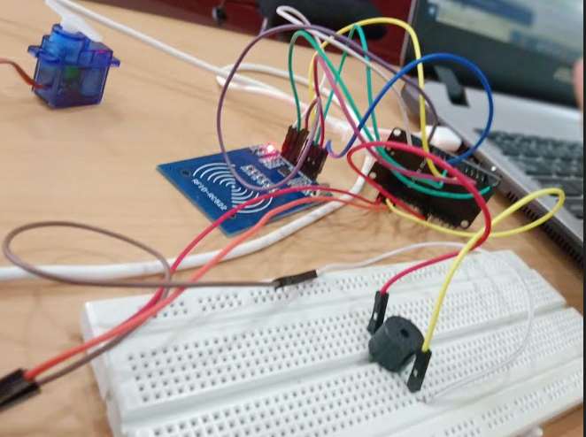
RESULT

Slide 8
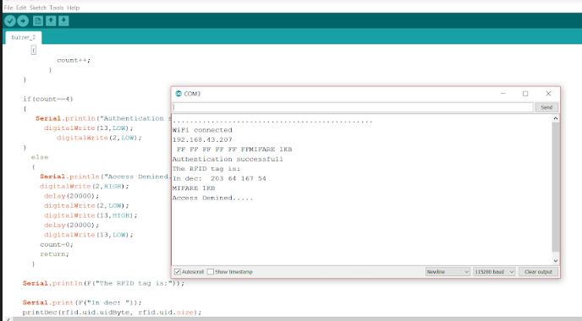
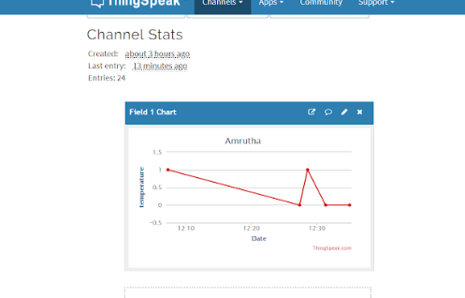

Slide 9
THANK YOU

